Slide 1
Hotel Management
Online help
Domain: Hotel and Hospitality Industry
Function: Revenue Management and Customer Retention

Slide 2
Table of contents
01
02
03
04
Objective
Problem statement
Tools Used
Dataset Overview

Slide 3
Table of contents
05
06
07
08
Primary Insight
Analysis Workflow
Secondary Insight
Key findings & Recommendations

Slide 4

Problem Statement
Despite a significant customer base and a reasonable average daily rate, the hotel chain faces challenges in customer retention, revenue growth, and market diversification. The high proportion of non-repeating customers and the decrease in revenue despite increased average daily rates indicate potential issues in customer satisfaction, pricing strategy, and market positioning. Additionally, the concentration of customers from Portugal suggests an over-reliance on a single market, which could pose risks to long-term sustainability.

Slide 5

Objective
The primary objective is to enhance revenue growth, improve customer retention, and diversify the customer base while maintaining competitive pricing. This involves optimizing room allocation, refining pricing strategies across different seasons and customer segments, improving the overall customer experience to encourage repeat visits, and expanding marketing efforts to attract a more diverse international clientele.

Slide 6



Tools Used
Analytical and Visual
Microsoft Power BI
Presentation
Microsoft Powerpoint

Slide 7
Dataset Overview
Data source: Internet
Time period: 2015-2017
Data size: hotel_bookings (119391, 33)
Key columns:
Actual Columns: Year, Quarter, is_repeated_guest, hotel, reservation_status, market_segment, customer_type, arrival_date, is_repeated_guest etc.
Dax/Calculated columns: Average Daily Rate, Total Revenue, Average days in waiting list, Average lead time, Money Lost due to cancelation, Booking to stay rate, Total stayed customer etc.

Slide 8
Analysis Workflow
Data Cleaning
Applied conditional column
Step 1
Step 2
Step 3
Load data in power bi
Step 5
Step 4
Data Visualization
DAX

Slide 9
Primary Insights
62.96%
Retention rate
$16.28
Lost due to cancellation
1.59
Average days in waiting
$26M
Total Revenue
79.99
Avg lead time (in days)
75K
Total stayed customer
$99.99
Avg daily rate

Slide 10
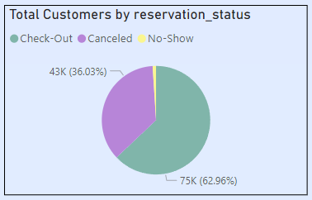
Secondary Insights
Recommendation:
Try to learn why our customers are canceling orders. Also try to understand why we get no show. Take customer feedback and necessary steps to increase checked out customers.
Most customers have Checked-out.

Slide 11
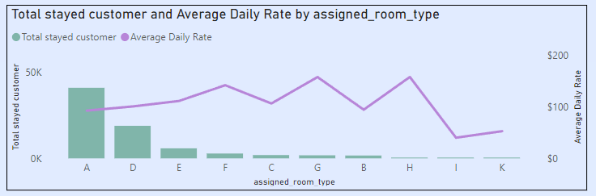
Secondary Insights
Recommendation:
Focus on promoting Room Type A to maintain its high occupancy and maximize revenue. Consider implementing targeted marketing strategies and loyalty programs for frequent customers. Monitor pricing trends for other room types to identify opportunities for dynamic pricing adjustments. Analyze customer feedback to ensure Room Type A continues to meet guest expectations and standards.
Room type A has highest customer and average daily rate

Slide 12
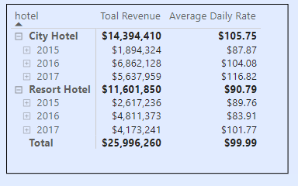
Secondary Insights
Recommendation:
Investigate factors contributing to the revenue decrease despite the higher average daily rate for both City and Resort hotels. Consider strategies to boost occupancy rates, such as targeted promotions or special packages. Enhance guest experiences to encourage repeat stays and positive reviews. Optimize pricing strategies to balance rate increases with demand.
Both City hotel & Resort hotel’s Average daily rate increased but revenue decreased.

Slide 13
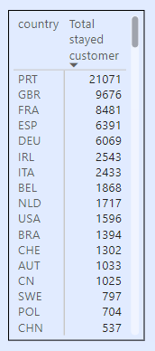
Secondary Insights
Most customers are from Portugal more than double of UK.
Recommendation:
Focus marketing efforts on Portugal to leverage the high customer base and increase repeat visits. Explore opportunities to attract more customers from the UK with targeted promotions. Expand outreach in other countries to diversify the customer base. Enhance services and offerings that appeal to Portuguese guests to maintain loyalty and satisfaction.

Slide 14
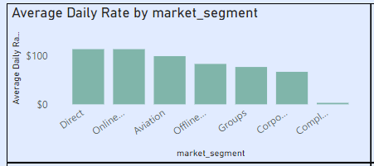
Secondary Insights
Recommendation:
Prioritize partnerships with direct booking channels and online travel agencies (TA) to maximize revenue from these high-yield segments. Enhance the booking experience and offer exclusive deals to attract more customers through these channels. Monitor and adjust pricing strategies to maintain competitiveness. Invest in targeted marketing campaigns to further boost bookings through direct and online TA segments.
Direct and online TA has highest and similar average daily rate.

Slide 15
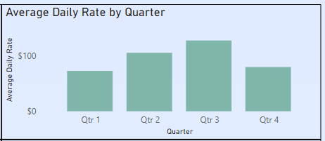
Secondary Insights
Recommendation:
Capitalize on the high average daily rate in Quarter 3 by implementing premium pricing strategies and exclusive packages. Enhance marketing efforts leading up to and during this period to attract high-value customers. Analyze demand patterns to optimize room availability and maximize occupancy. Offer special promotions and events to further boost revenue in Quarter 3.
Quarter 3 has highest average daily rate

Slide 16
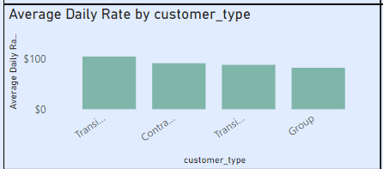
Secondary Insights
Recommendation:
Focus on attracting more transient and contract customers by offering tailored packages and flexible booking options. Strengthen relationships with corporate clients to secure more contract bookings. Enhance marketing efforts targeting transient travelers. Continuously monitor and adjust pricing strategies to maintain high average daily rates while maximizing occupancy.
Transient & contract has highest average daily rate

Slide 17
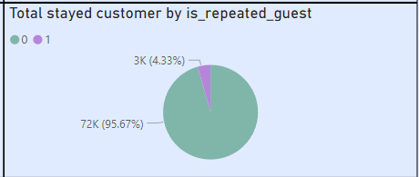
Secondary Insights
Recommendation:
Implement loyalty programs and incentives to encourage repeat bookings. Enhance the overall guest experience to increase satisfaction and likelihood of return visits. Collect and analyze feedback from non-repeating customers to identify areas for improvement. Offer personalized promotions and discounts for previous guests to incentivize repeat stays.
Most of our customer are non-repeating

Slide 18
Key findings
This analysis provides a comprehensive overview of hotels. The key insights reveal 75K total stayed customer, a retention rate of 62.96%, an average daily rate of $99.99 & a revenue of $26M. The average lead time 78 days, with an average waiting time of 1 and half days.
Key findings include:
Most customers have Checked-out.
Room type A has highest customer and average daily rate
Both City hotel & Resort hotel’s Average daily rate increased but revenue decreased.
Most customers are from Portugal more than double of UK.
Direct and online TA has highest and similar average daily rate.
Quarter 3 has highest average daily rate.
Transient & contract has highest average daily rate
Most of our customer are non-repeating

Slide 19
Recommendations
Customer Retention Strategy: Develop a robust loyalty program to convert one-time guests into repeat customers. Offer incentives for return visits and personalized experiences based on customer preferences.
Pricing Optimization: Analyze the inverse relationship between increased average daily rates and decreased revenue. Implement dynamic pricing strategies that balance occupancy rates with revenue maximization, especially during peak seasons (Quarter 3).
Market Diversification: Expand marketing efforts to attract more customers from countries other than Portugal. Focus on growing the UK market and other potential international segments.
Room Type Optimization: Capitalize on the popularity and higher rates of Room Type A. Consider renovating other room types to match its appeal or create unique selling points for each room category.
Distribution Channel Management: Leverage the high average daily rates from direct and online TA bookings. Develop strategies to increase bookings through these channels, possibly through exclusive deals or improved user experience on the hotel's website.

Slide 20
Recommendations
Seasonal Strategies: Develop targeted marketing campaigns and packages for different quarters, with a focus on increasing occupancy during lower-demand periods while maintaining the high rates in Quarter 3.
Customer Segment Focus: Analyze the needs of transient and contract customers to enhance their experience and potentially increase their length of stay or frequency of visits.
Operational Efficiency: Reduce the average waiting time to improve customer satisfaction upon arrival. Implement technologies or processes to streamline check-in and check-out procedures.
Lead Time Management: Utilize the average lead time of 78 days to implement early booking discounts or packages, encouraging more advance reservations and better resource planning.
Customer Experience Enhancement: Investigate reasons for the high rate of non-repeating customers. Conduct post-stay surveys and implement changes based on feedback to improve overall satisfaction and encourage return visits.

Slide 21
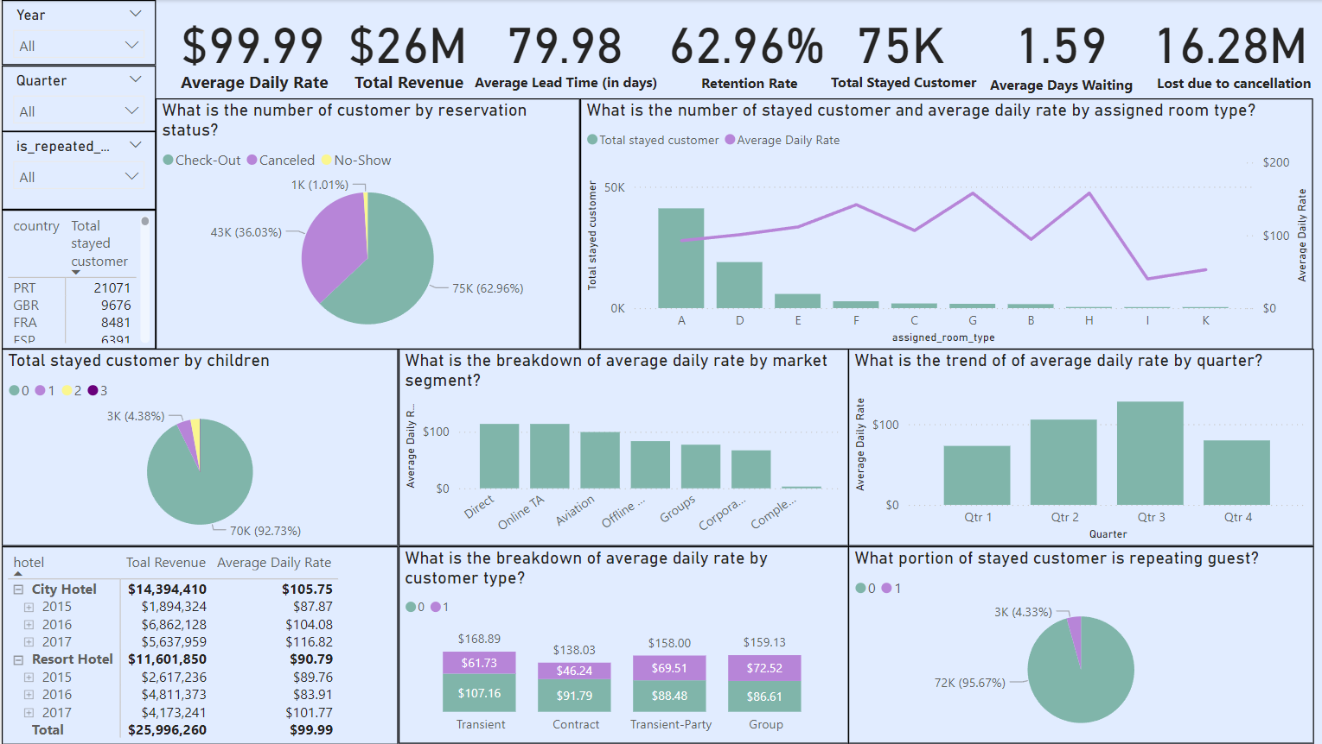
Dashboard

Slide 22


Thanks!
-Amanat Mahmud

